Slide 1

Vehicle Insurance Management System
Vims
Documentation
24/11/2019

Slide 2
TABLE OF CONTENTS
CERTIFICATE 1
ACKNOWLEGMENT 2
REQUIREMENTS SPECIFICATION 3
PROBLEM STATEMENT 4
REQUIREMENTS SUMMARY 5
HARDWARE/SOFTWARE REQUIRED 6
PROPOSED SOLUTION 7
DIAGRAMS 8
9
INTERFACE 10
TASK SHEET 11
USE CASES 12

Slide 3
CERTIFICATE This is to certify that this project “ Vehicle Insurance Management System ” is submitted of the ACCP-EE-201804F Semester 3 done by following candidate.
Name: Muhammad Jazzel Mehmood
Contact Number: 03482453559
Email: jazzelmehmood4@gmail.com
Enrollment Number: Student1107012

Slide 4

I am very thankful to ALMIGHTY ALLAH that by His Grace I have been successful. I am presenting my application (E-Project) and I have tried my best to take all relevant and necessary topics into our consideration so that this project may become comprehensive. This is my Semester-3 E-Project. I have strived for a better outlook to come. This project has been developed by using Asp .NET Web Application(MVC). I would like to thank Sir Hassan Awan for his guidance and for giving us time from his busy schedule & also express our sincere gratitude to I-Project team from Aptech (MSG) for their valuable guidance and support for the completion of this project. I earnestly hope that this project will provide all the necessary information required by the user to fulfill his/her inspiration. However, suggestion and feedbacks for Improvements will be thankfully welcomed & acknowledged. Thank You.
ACKNOWLEGMENT
4

Slide 5

REQUIREMENTS SPECIFICATION
PROBLEM STATEMENT:
The objective of the system is to provide the facilities to all the people concerned with Vehicle Insurance. From the management point of view works can be done fast and more accurately as compared to existing manual system. From the customer’s point of view he can get immediate services without any kind of wasting of time whereas from the user’s point of view all kinds of transitions can be done in very easy and efficient manner. The system also provides many kind of reports generation facility. Our main objectives for developing this project are giving below.
Data Security.
Reduced Paper Work.
Reduced Manpower.
Increased Operational Efficiency.
Increased Accuracy And Reliability.
Improve Moral.
Reduce Operational Time
This project aims to develop a complete fully functional independent system with the intension of improving the productivity of the operations of company through speedy and accurate processing and efficient storage and retrieval of data. The basic aim behind this project to provide a complete solution that manages the records of vehicle insurance company.This project is aimed to develop “Online Insurance Portal”. It is web-based application, which is developed mainly for the agents of the insurance company to take the policy for his clients electronically. By the request from his clients, he processes and maintains the policy details through the system. Online Insurance Portal System is an integrated insurance system which links up all the channels within the insurance industry. It is a revolutionized insurance solution that can facilitate online processing and services to the insurance partners, agents and customers through the Internet.
Vims

Slide 6

REQUIREMENTS SPECIFICATION
REQUIREMENTS SUMMARY:
The site should have menu categorising required functionalities;
About us
Types of insurance
Testimonials
Site map
Contact us
There should be 2 logins as mentioned below:
Customer:
User needs to register as customer by providing the necessary information in the registration form and provide the user name and password
Customer can login with unique user name and password.
He can change the password.
Can purchase the policy online: For purchasing the policy online, he has to fill in the application form which would capture all the required information about the vehicle. On successful payment, copy of policy would be generated which customer can save for the records.
Initiate the claim by filling the claim form.
Employee:
Employee will be admin who can login with admin user name and password.
He can perform all the admin functions as maintaining the policy records, claim records, payment schedules etc
Following reports needs to be generated
Monthly sell of policies
Vehicle wise analysis
Claims report
Policies due renewals
Policies lapsed report
Vims

Slide 7

HARDWARE/SOFTWARE REQUIRED.
Hardware
A minimum computer system that will help you access all the tools in the courses is a Pentium 166 or better .
128 Megabytes of RAM or better.
Software
Visual Studio .NET / ASP
IIS server
.NET Framework
Java Virtual Machine/ J2EE server
Notepad/Java editor
j2sdk1.4.1_02 (or later).
EJB Dev Kit
Java enabled web server
JSP / Servlets Dev. Kit
Vims

Slide 8

PROPOSED SOLUTION
This project aims to develop a complete fully functional independent system with the intension of improving the productivity of the operations of company through speedy and accurate processing and efficient storage and retrieval of data. The basic aim behind this project to provide a complete solution that manages the records of vehicle insurance company.This project is aimed to develop “Online Insurance Portal”. It is web-based application, which is developed mainly for the agents of the insurance company to take the policy for his clients electronically. By the request from his clients, he processes and maintains the policy details through the system. Online Insurance Portal System is an integrated insurance system which links up all the channels within the insurance industry. It is a revolutionized insurance solution that can facilitate online processing and services to the insurance partners, agents and customers through the Internet.
Vims

Slide 9
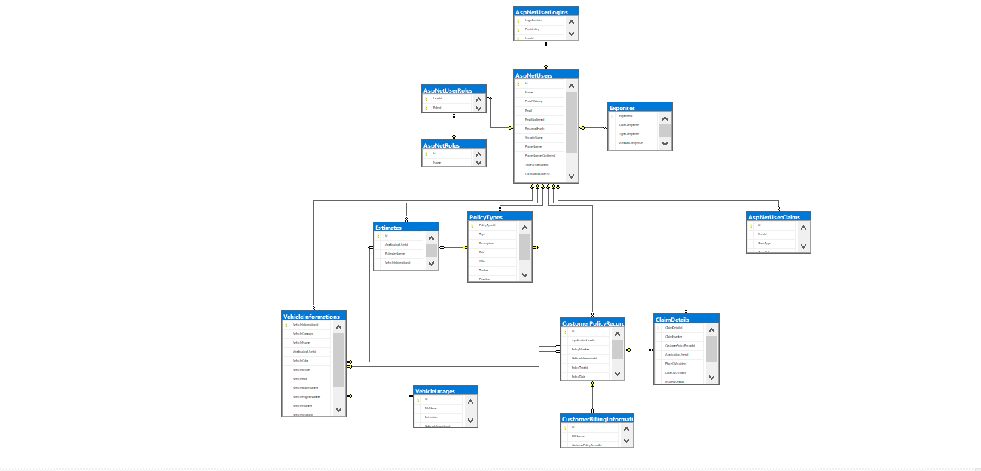
DIAGRAMS
9

Slide 10
DIAGRAMS
ARCHITECTURE DIAGRAM
FLOWCHART
Admin
Employee
Visitors
Customers
Employee
Customer
10

Slide 11
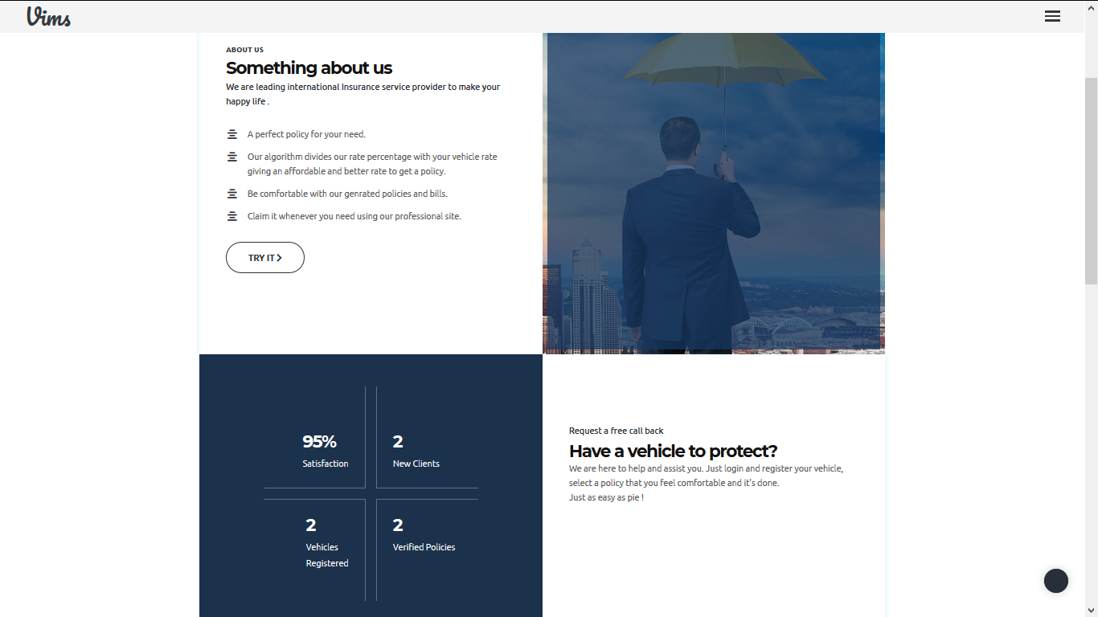
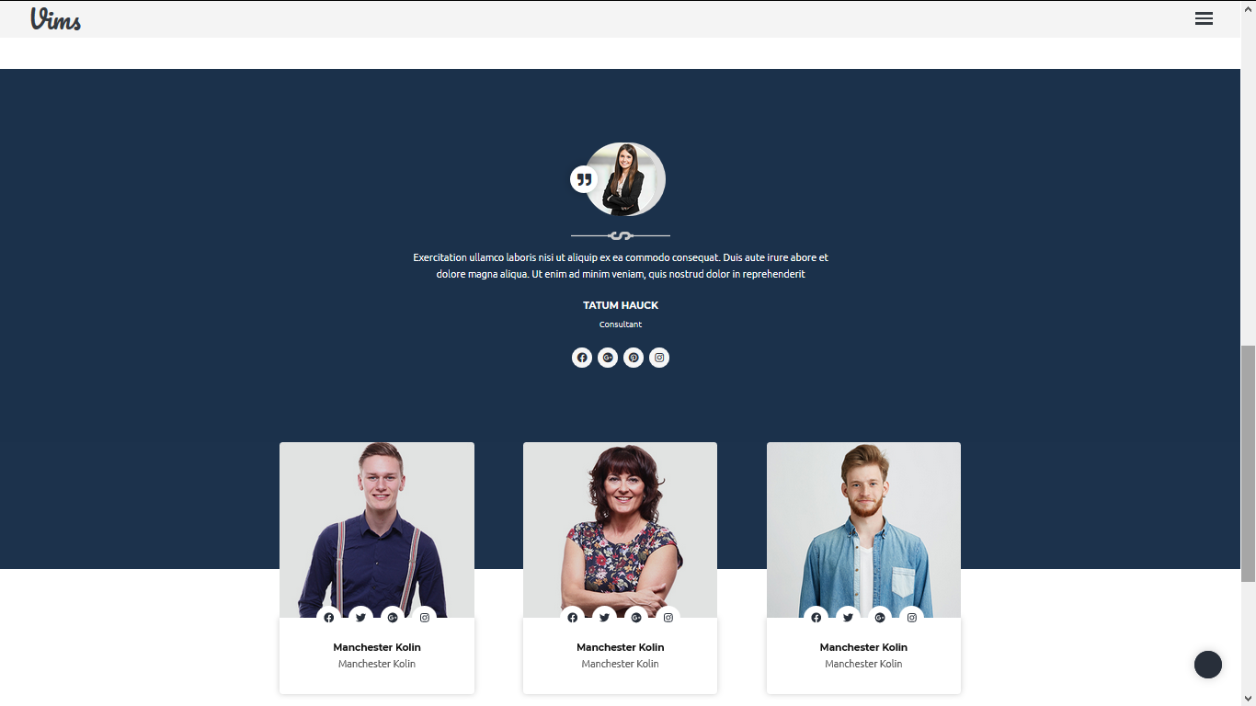
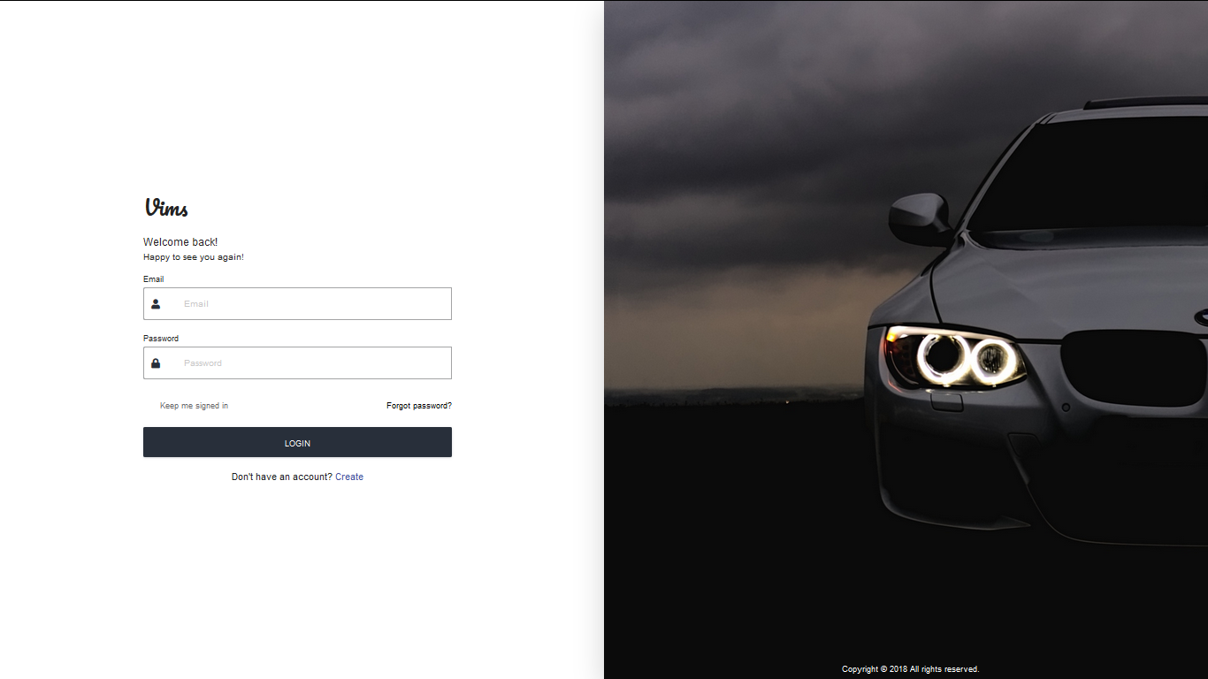
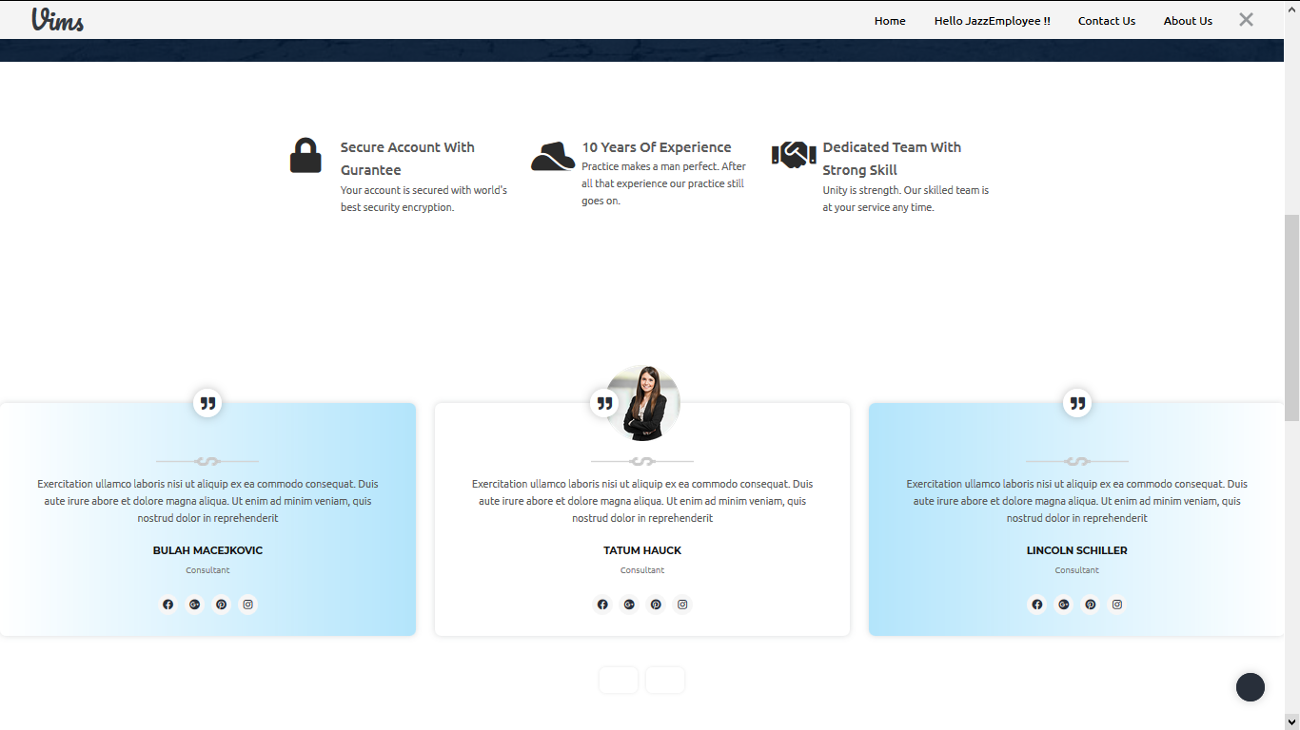
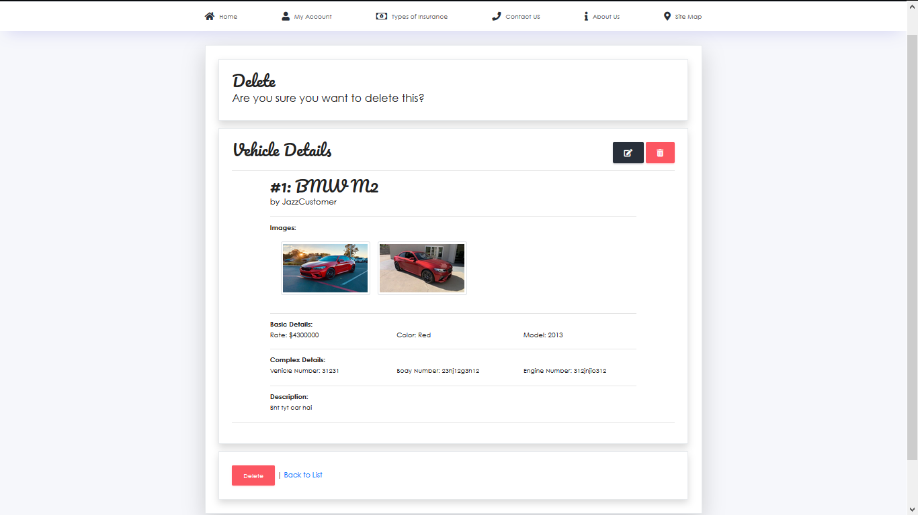
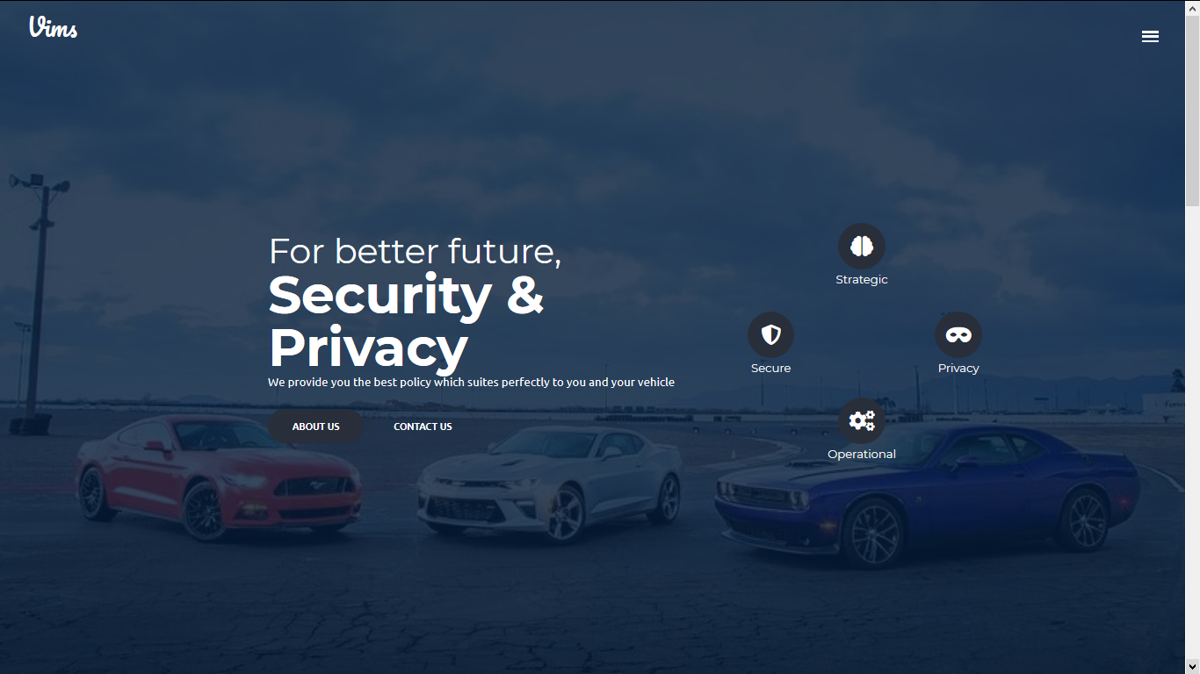
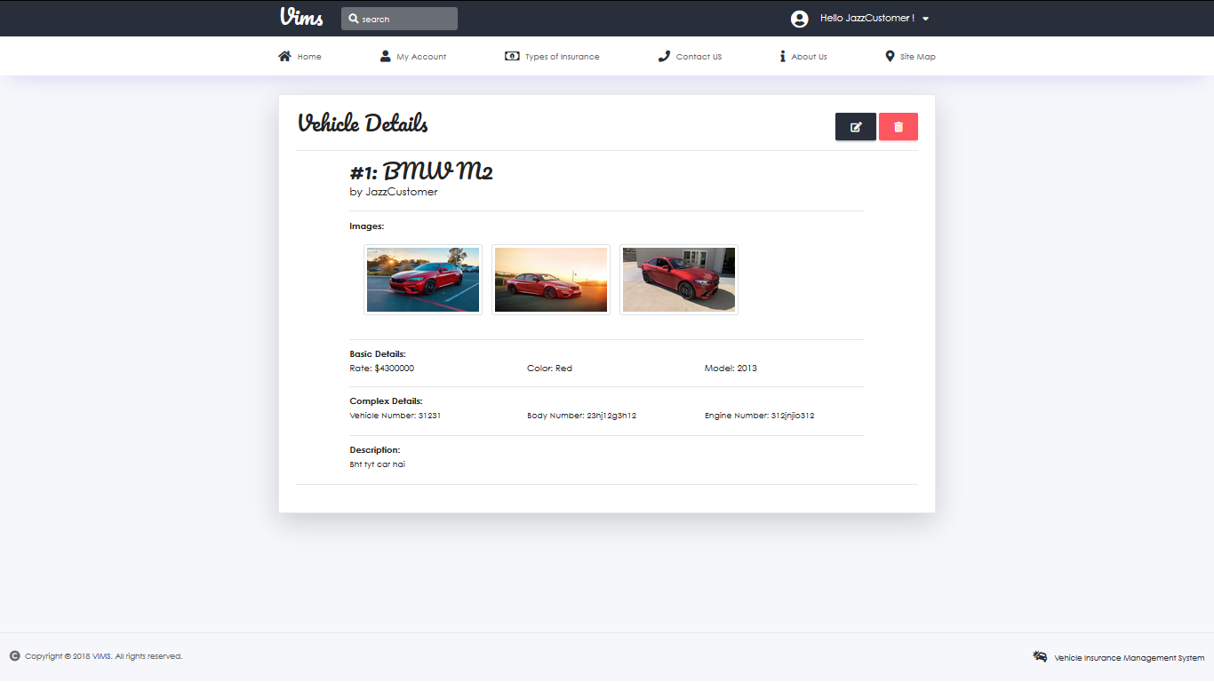
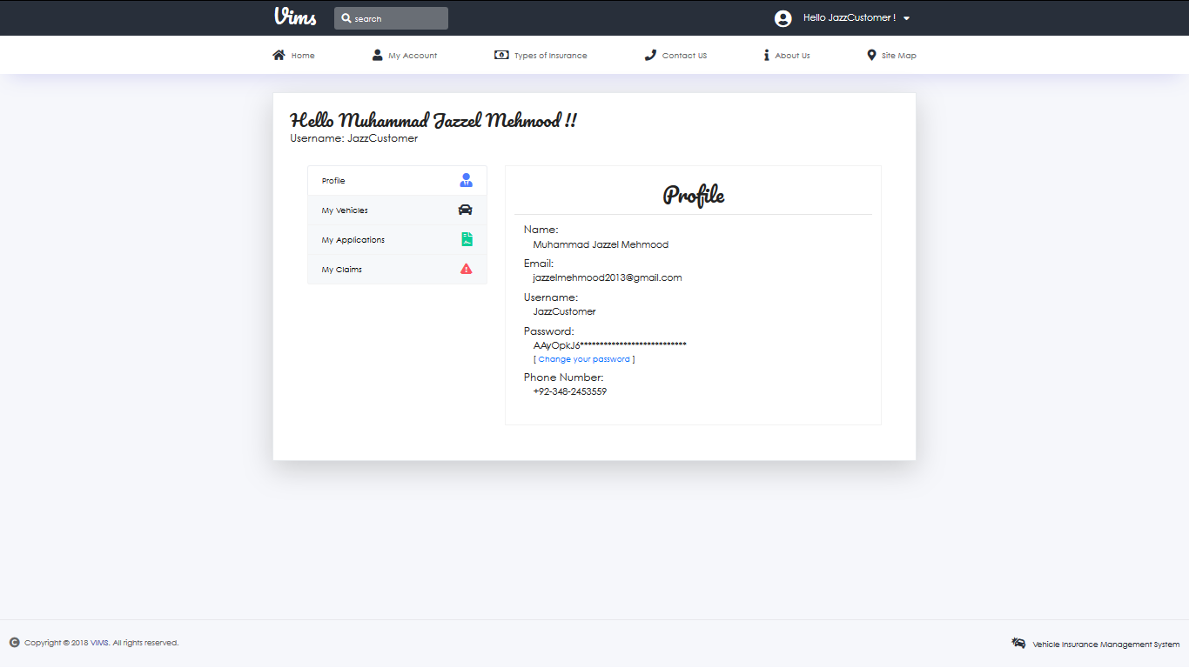
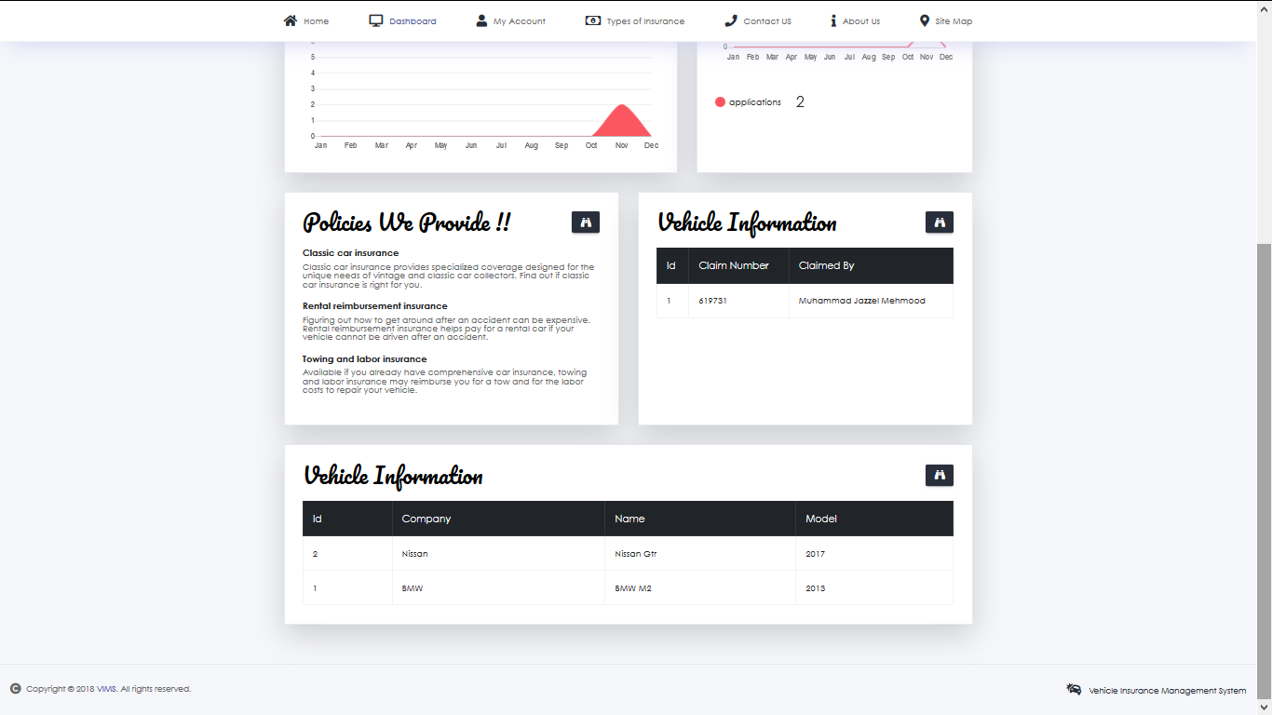
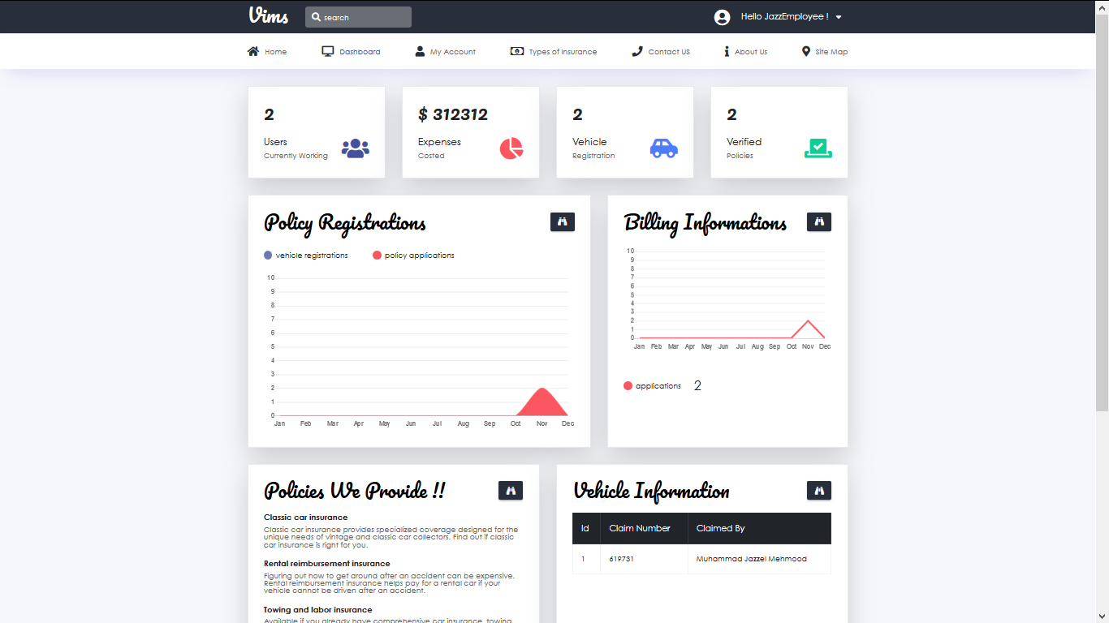
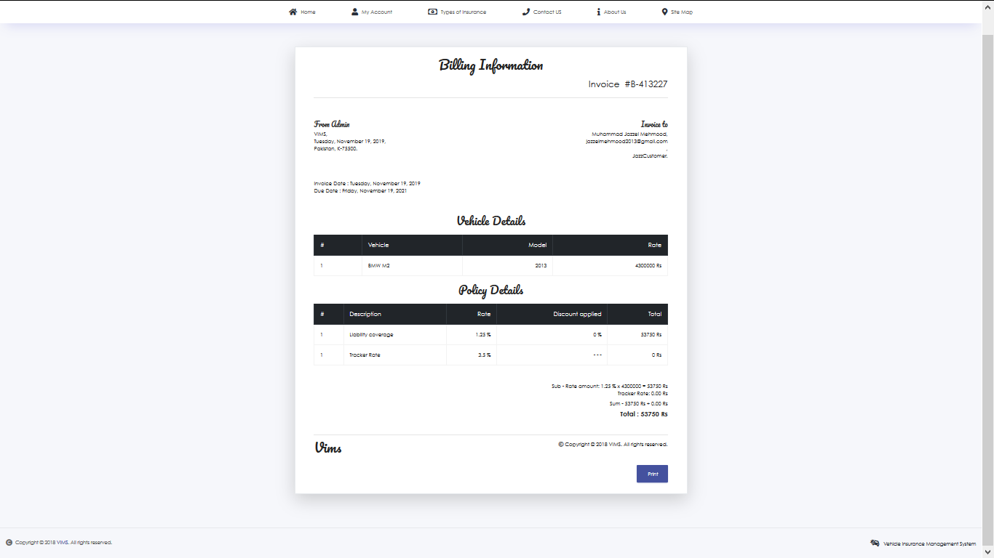
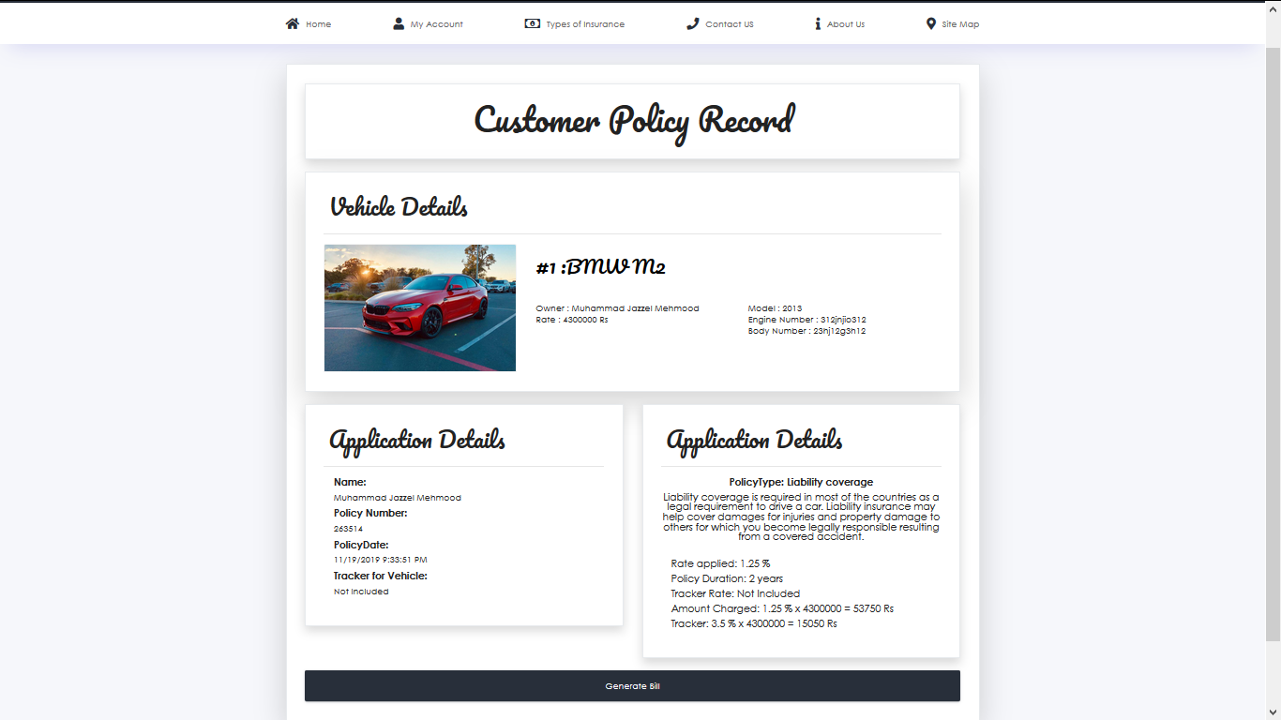
INTERFACE
12

Slide 12
TASK SHEET
PROJECT REFERENCE |  | PROJECT TITLE | ACITIVITY PLAN PREPARED BY |  | DATE OF PREPARATION
SR.NO | TASK |  | Muhammad Jazzel Mehmood | START DATE | DAYS COVERED | STATUS
1. | Problem Definition | VEHICLE INSURANCE MANAGEMET SYSTEM |  | 25/Oct/19 | 1 | Done
2. | Architecture & Design of Project |  |  | 25/Oct/19 | 3 | Done
3. | Use case diagram |  |  | 25/Oct/19 | 1 | Done
4. | Activity diagram |  |  | 25/Oct/19 | 1 | Done
5. | Database Design |  |  | 25/Oct/19 | 1 | Done
6. | UI & Business components |  |  | 25/Oct/19 | 8 | Done
7. | Documentation |  |  | 25/Oct/19 | 1 | Done
11

Slide 13

USE CASES
Actors: actors used in item of website
Employee as admin
Customer as visitors
Employee
Customer
Vims

Slide 14





THANK YOU!
Muhammad Jazzel Mehmood
+92 3482453559
jazzelmehmood4@gmail.com
https://github.com/Jazzel

